Slide 1
Embedding Layer
In deep learning, an embedding layer is a layer that is commonly used in neural network architectures for natural language processing (NLP) tasks, such as text classification, language translation, and sentiment analysis. The primary purpose of an embedding layer is to learn and represent high-dimensional data in a lower-dimensional space, typically with much fewer dimensions, while preserving semantic relationships between data points.

Slide 2
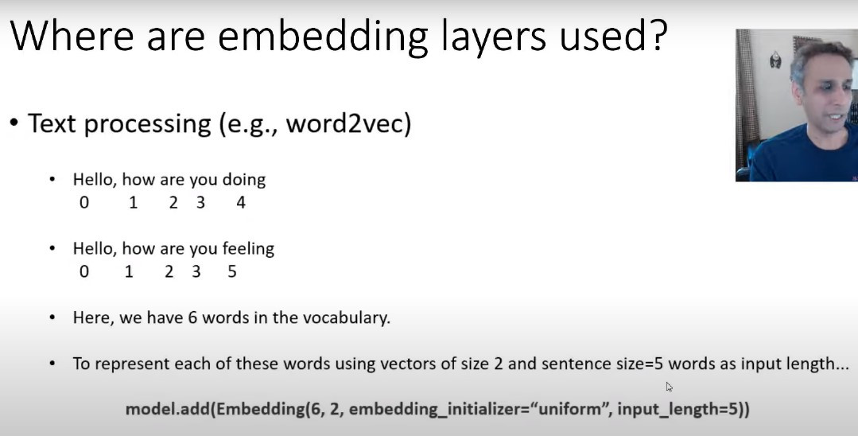

Slide 3
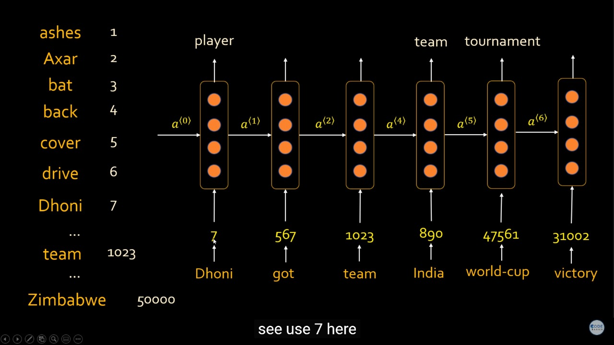
5000 is represent an entire words in a vocabulary. Or total number of unique words in a text

Slide 4
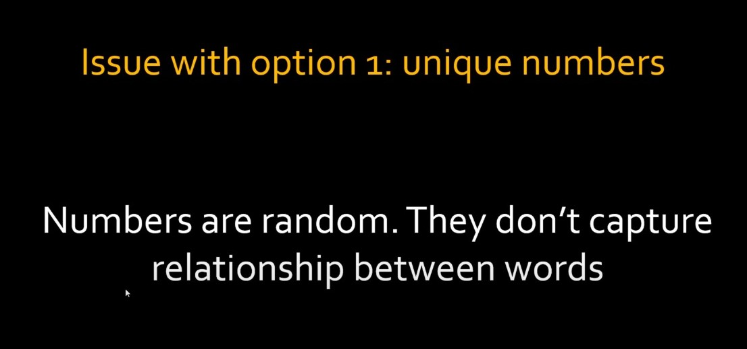

Slide 5


Slide 6
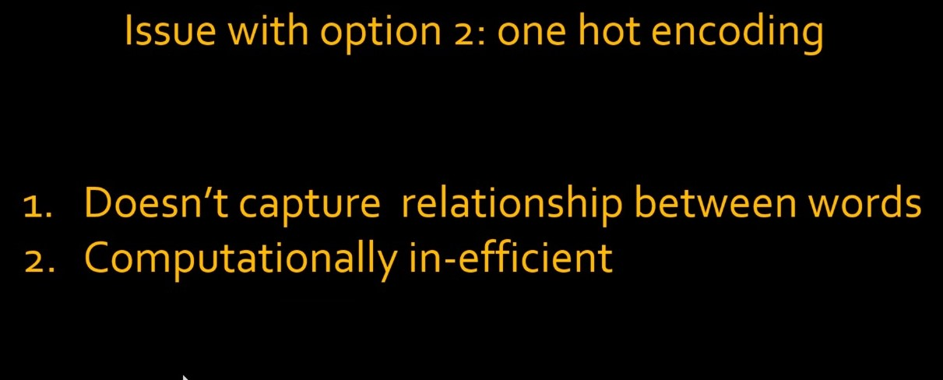

Slide 7
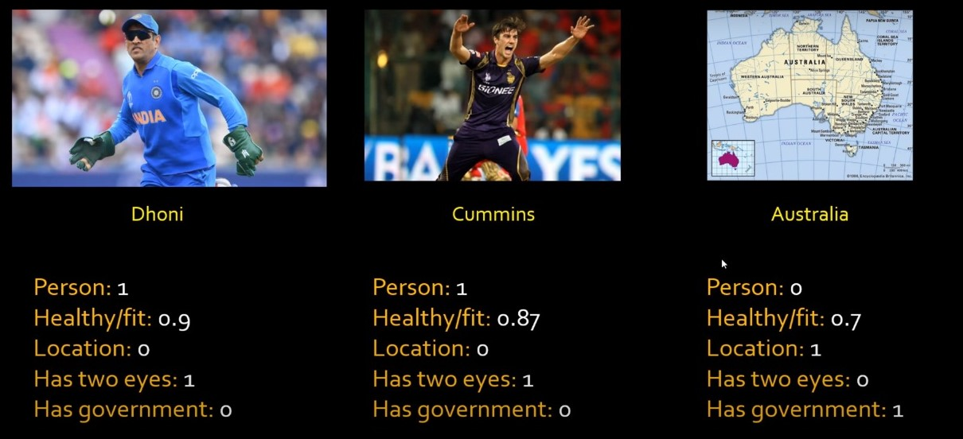

Slide 8
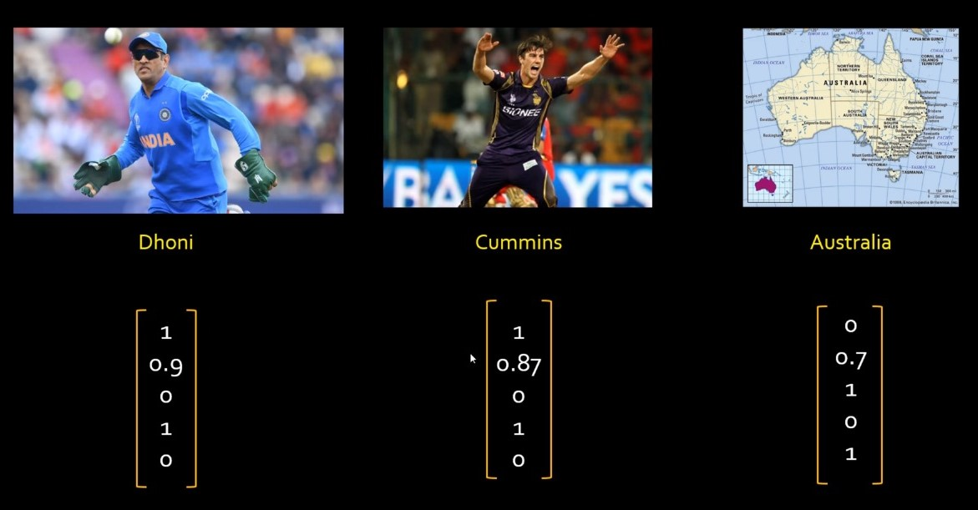

Slide 9
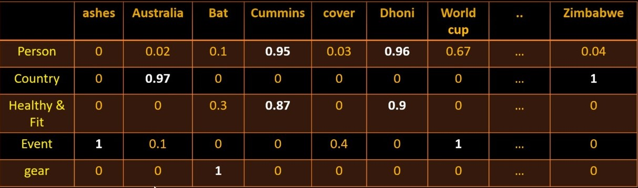

Slide 10
